Slide 1







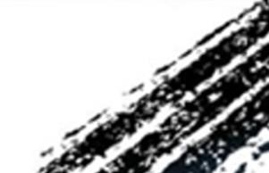

ATAI
Advanced Techniqueof Artificial Intelligence
ATAI
ChongqingUniversity _{AdvancedTechniqueof}
of Technology Artificial Intelligence
Chongqing University of
Technology
Chongqing University ^{ATAI}
_{of Technology} Advanced Techniqueof
Artificial Intelligence
Chongqing University of Technology
Chongqing University of Technology
Neural LightRig: Unlocking Accurate Object Normal and Material Estimation with Multi-Light Diffusion
code: no
—— CVPR 2025
Reported by ZhenDong Huang
1

Slide 2

ATAI
AdvancedTechniqueof
Artificial Intelligence
ATAI
ChongqingUniversity _{AdvancedTechniqueof}
of Technology Artificial Intelligence
ChongqingUniversity of Technology
Motivation
1. their quality and generalizability still remain challenging, due to the inherently ill-posed nature of
inferring geometry and materials from a single image
2.such methods often require complex capture systems with sophisticated cameras or lighting setups, which can be costly and impractical for in-the-wild images.

Slide 3

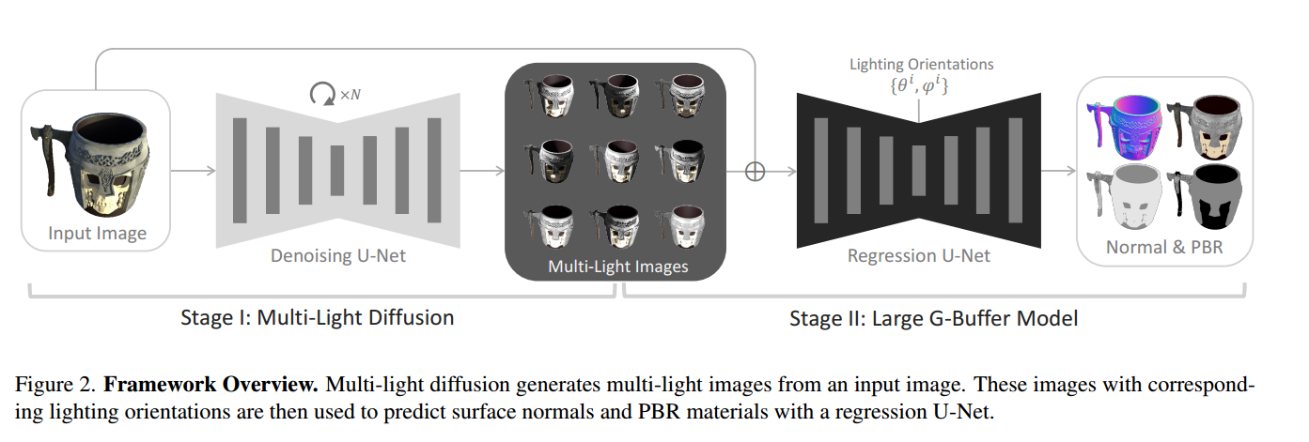
ChongqingUniversity of Technology
ATAI
AdvancedTechniqueof
Artificial Intelligence
ATAI
ChongqingUniversity _{AdvancedTechniqueof}
of Technology Artificial Intelligence
Overview

Slide 4
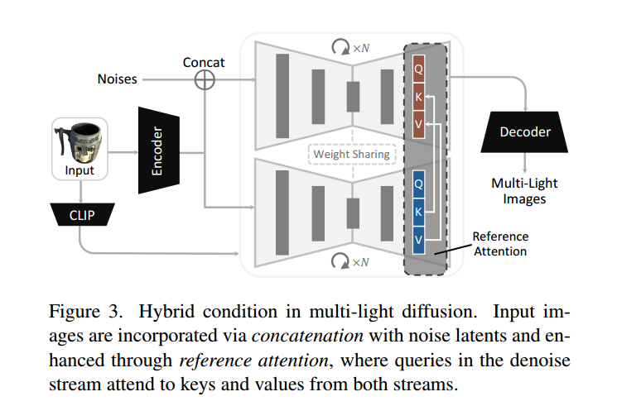
ChongqingUniversity of Technology
ATAI
AdvancedTechniqueof
Artificial Intelligence
ATAI
ChongqingUniversity _{AdvancedTechniqueof}
of Technology Artificial Intelligence
Overview

Slide 5






ChongqingUniversity of Technology
ATAI
AdvancedTechniqueof
Artificial Intelligence
ATAI
ChongqingUniversity _{AdvancedTechniqueof}
of Technology Artificial Intelligence
Method

Slide 6

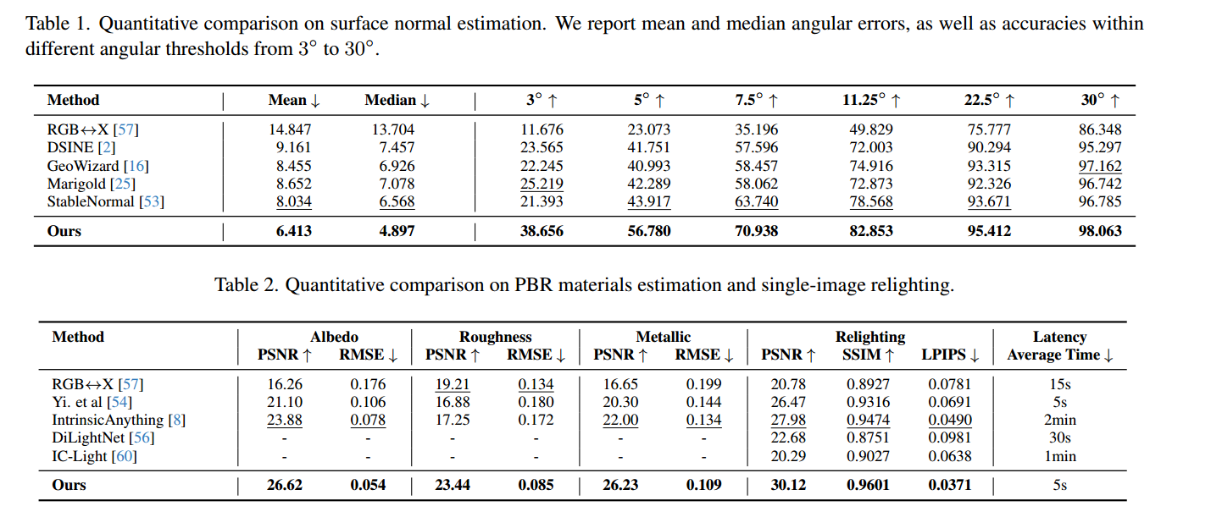
ATAI
AdvancedTechniqueof
Artificial Intelligence
ATAI
ChongqingUniversity _{AdvancedTechniqueof}
of Technology Artificial Intelligence
ChongqingUniversity of Technology
Experiments

Slide 7
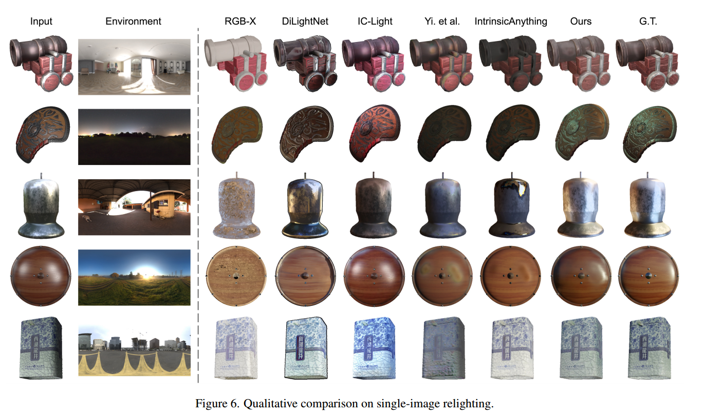
ATAI
AdvancedTechniqueof
Artificial Intelligence
ATAI
ChongqingUniversity _{AdvancedTechniqueof}
of Technology Artificial Intelligence
ChongqingUniversity of Technology
Experiments

Slide 8
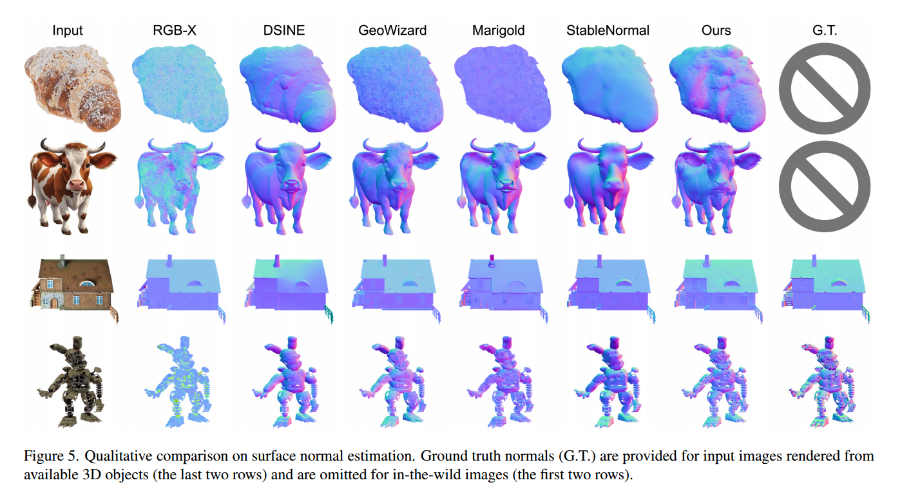
ATAI
AdvancedTechniqueof
Artificial Intelligence
ATAI
ChongqingUniversity _{AdvancedTechniqueof}
of Technology Artificial Intelligence
ChongqingUniversity of Technology
Experiments

Slide 9
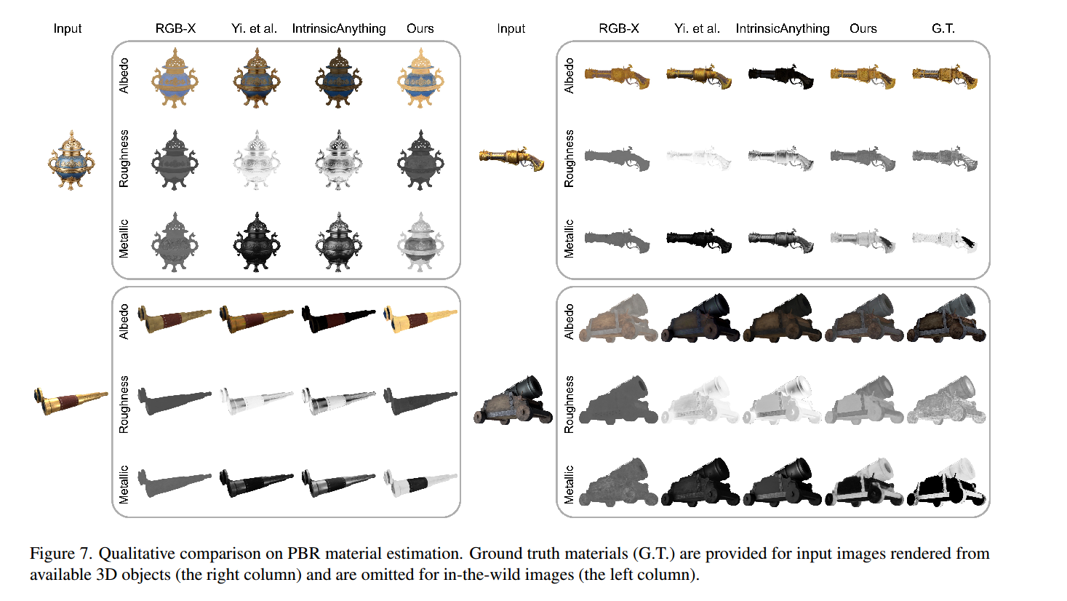
ATAI
AdvancedTechniqueof
Artificial Intelligence
ATAI
ChongqingUniversity _{AdvancedTechniqueof}
of Technology Artificial Intelligence
ChongqingUniversity of Technology
Experiments

Slide 10
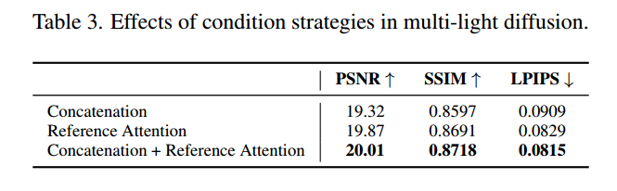
ATAI
AdvancedTechniqueof
Artificial Intelligence
ATAI
ChongqingUniversity _{AdvancedTechniqueof}
of Technology Artificial Intelligence
ChongqingUniversity of Technology
Experiments

Slide 11
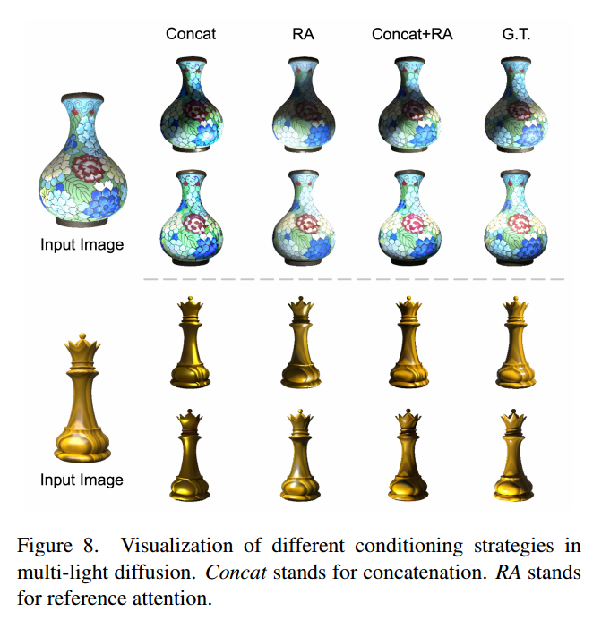
ATAI
AdvancedTechniqueof
Artificial Intelligence
ATAI
ChongqingUniversity _{AdvancedTechniqueof}
of Technology Artificial Intelligence
ChongqingUniversity of Technology
Experiments

Slide 12
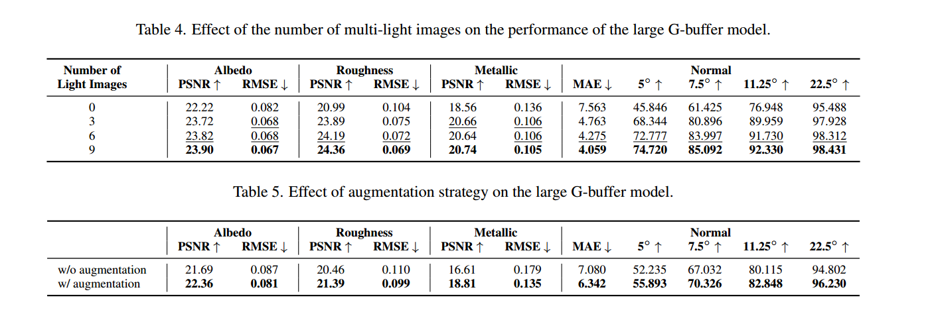
ATAI
AdvancedTechniqueof
Artificial Intelligence
ATAI
ChongqingUniversity _{AdvancedTechniqueof}
of Technology Artificial Intelligence
ChongqingUniversity of Technology
Experiments

Slide 13
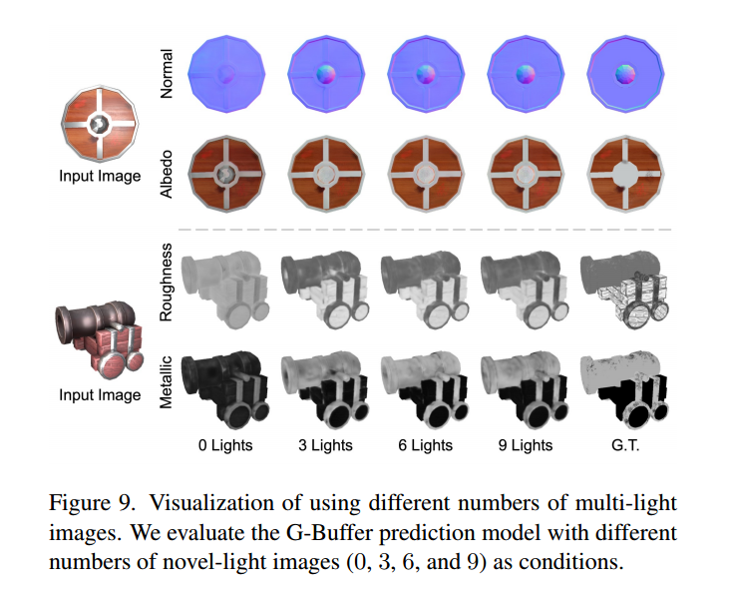
ATAI
AdvancedTechniqueof
Artificial Intelligence
ATAI
ChongqingUniversity _{AdvancedTechniqueof}
of Technology Artificial Intelligence
ChongqingUniversity of Technology
Experiments

Slide 14
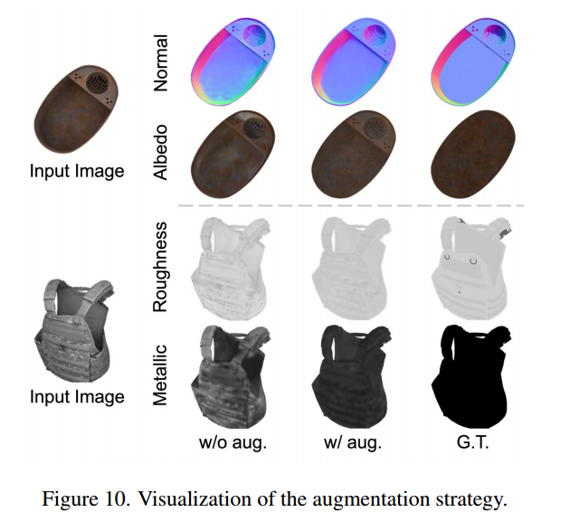
ATAI
AdvancedTechniqueof
Artificial Intelligence
ATAI
ChongqingUniversity _{AdvancedTechniqueof}
of Technology Artificial Intelligence
ChongqingUniversity of Technology
Experiments

Slide 15


ChongqingUniversity of Technology
ATAI
AdvancedTechniqueof
Artificial Intelligence
ATAI
ChongqingUniversity _{AdvancedTechniqueof}
of Technology Artificial Intelligence
Thanks!

